Slide 1
Metadata Collections Analytics Tool: Recommendations Analysis Dashboard
Sean Gordon
The HDF Group

Slide 2
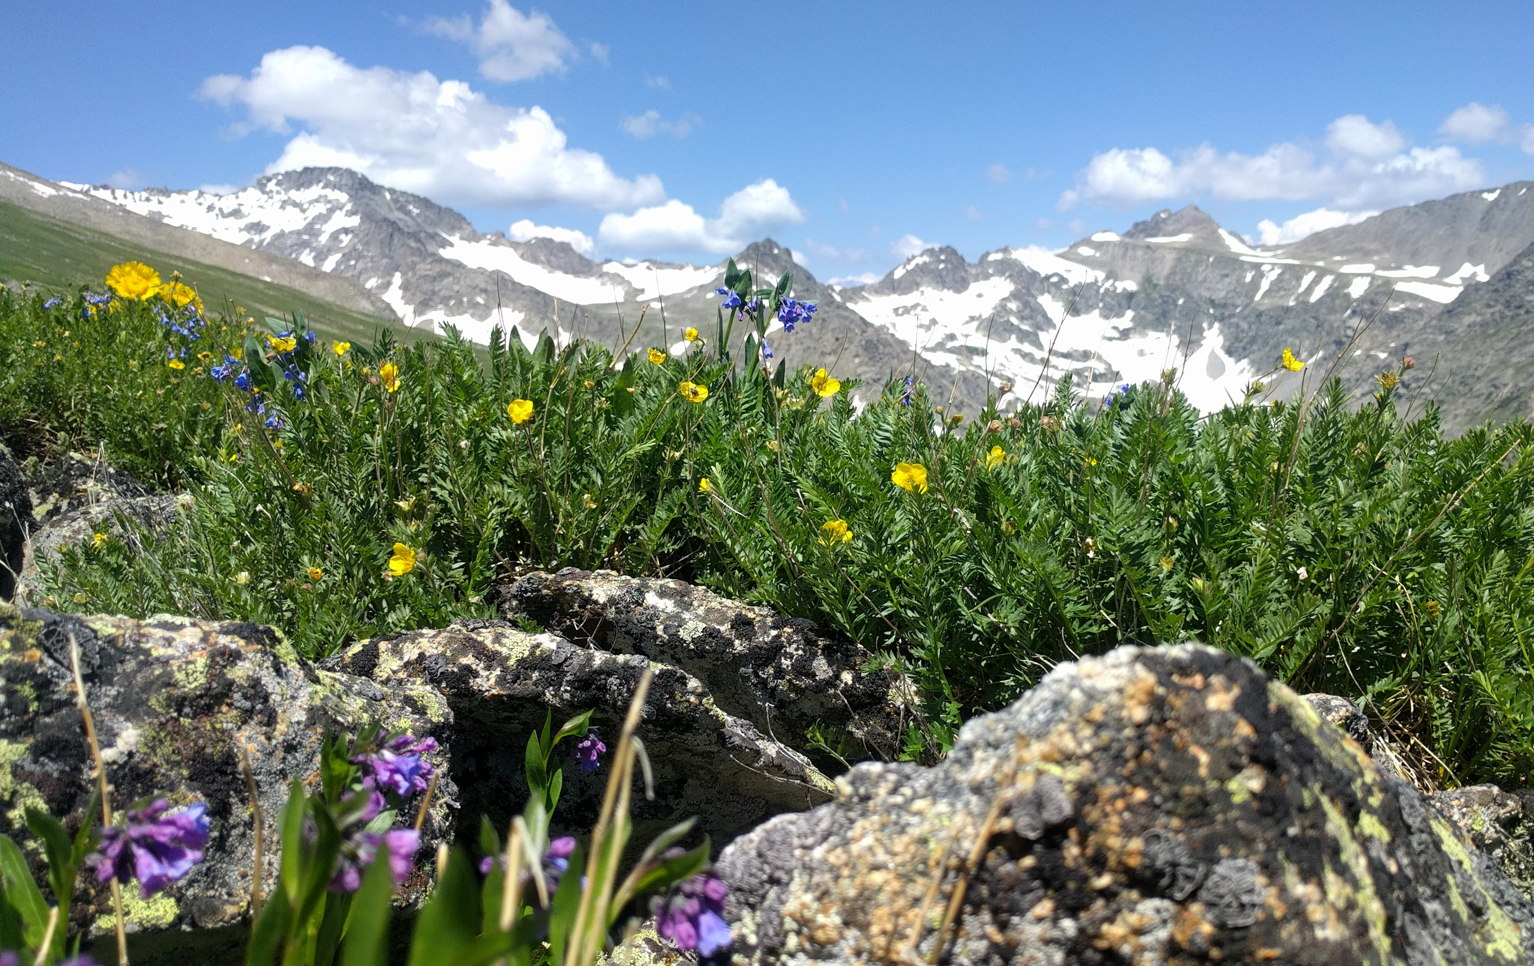
Why not just a presentation?
Tell me, I'll forget. Show me, I may remember. But involve me, and I'll understand.

Slide 3
Terminology
Collection: A group of metadata records, commonly organized by a data center, organization or project and often stored in a database or web accessible folder.
Concept : General term for describing a documentation entity (e.g. Title, Revision Date, Process Step, Spatial Extent).
Dialect : A particular form of the documentation language that is specific to a community (e.g. DIF, CSDGM, EML, ECHO).
Recommendation: A set of concepts that a group believes is required for achieving a documentation goal.
Profile: A set of concepts required to support a particular documentation need or use case for a recommendation.

Slide 4
How it works
Data table : A table that includes a row for each concept in each record that includes the collection name, the dialect, the record is documented in, the record name, and concept name
Recommendations table : Each recommendation is comprised of a number of profiles which are generally ordered by importance or necessity of the concepts included
Dialect Table: Each dialect is comprised of definitions for the concepts it includes.
Analysis: Each record is assessed for the concepts in each recommendation profile and is assigned a 1, 0, or -1 for contains, doesn’t contain, or cannot contain.

Slide 5
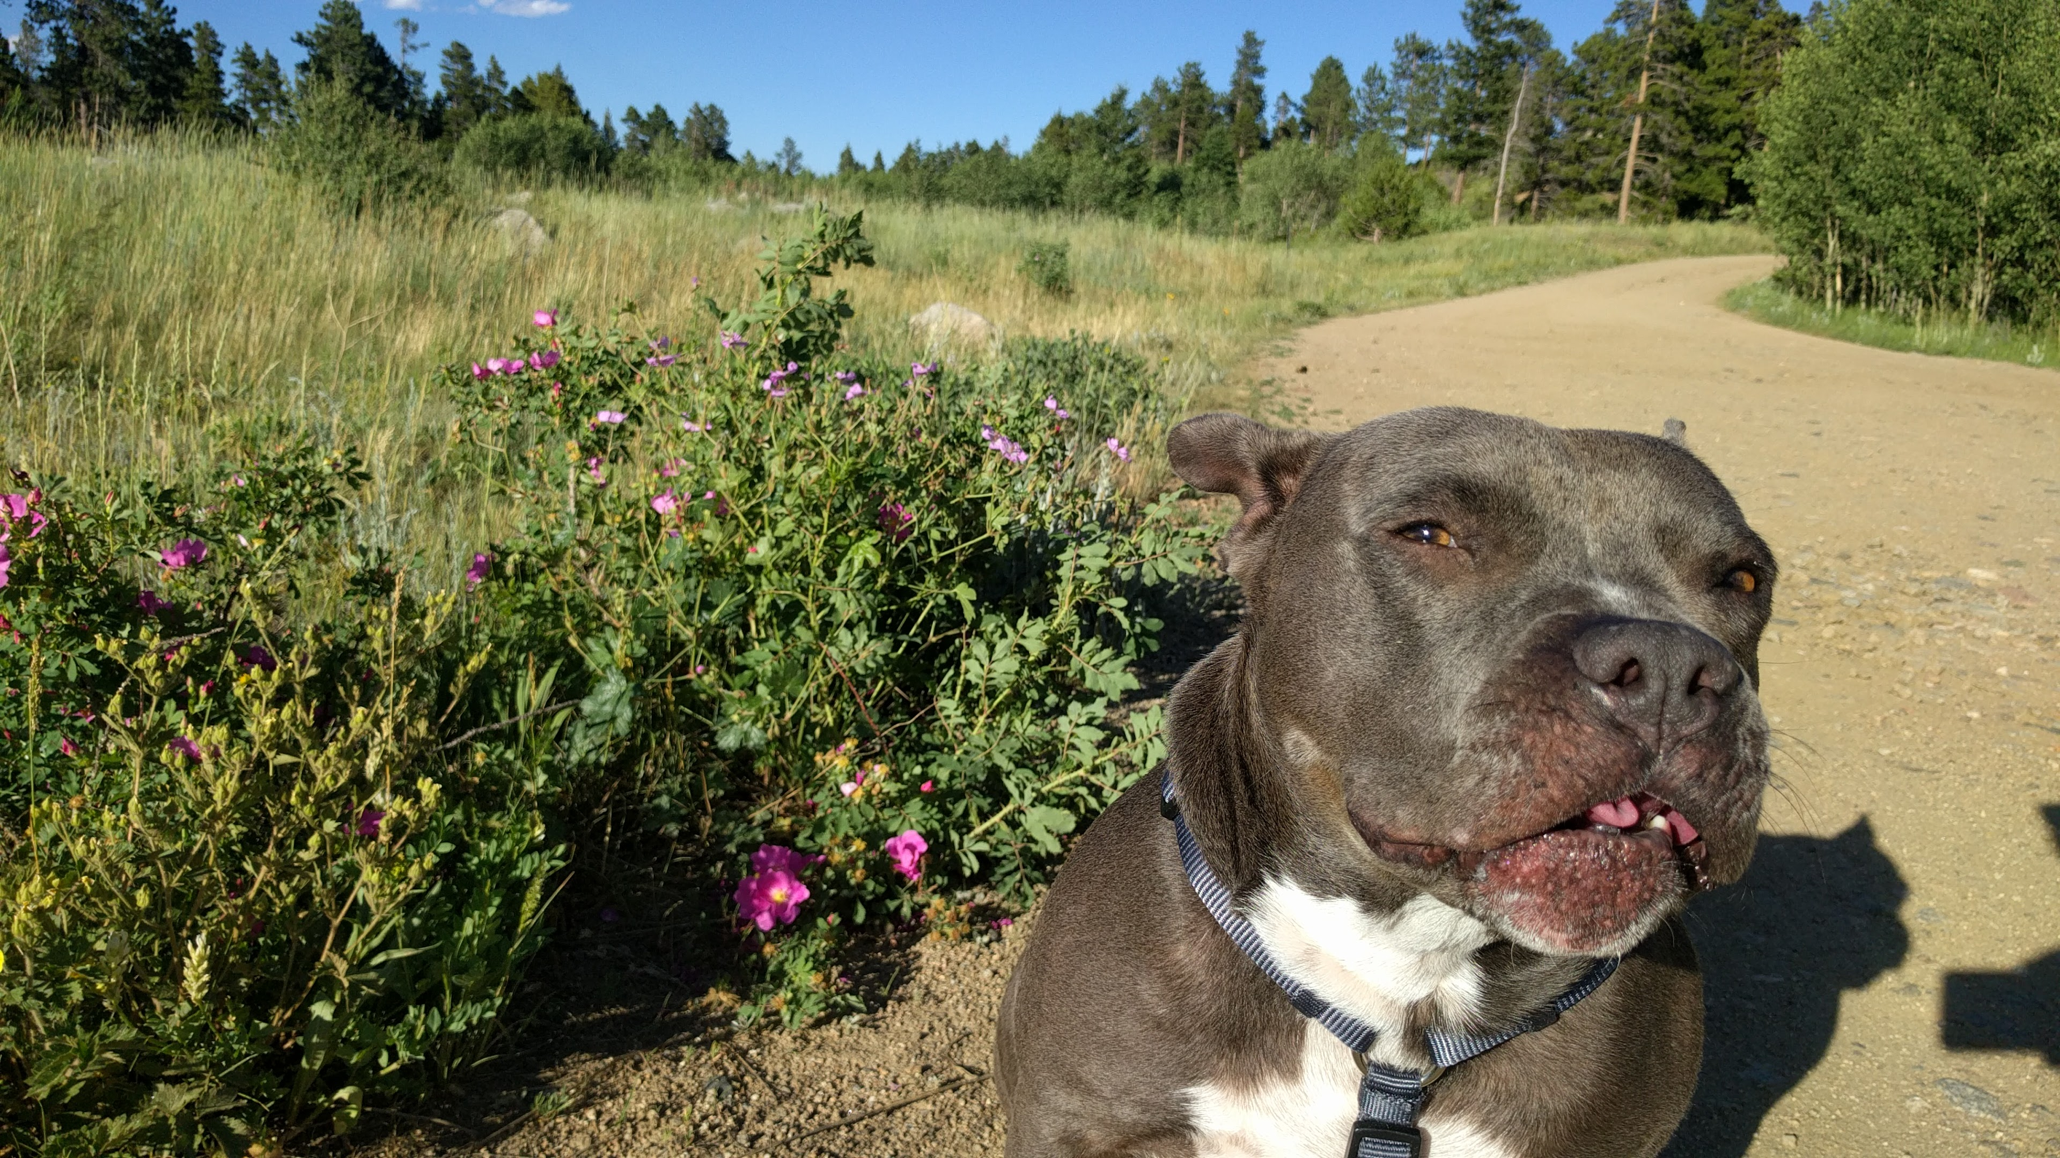
Why don’t you just show me?

Slide 6
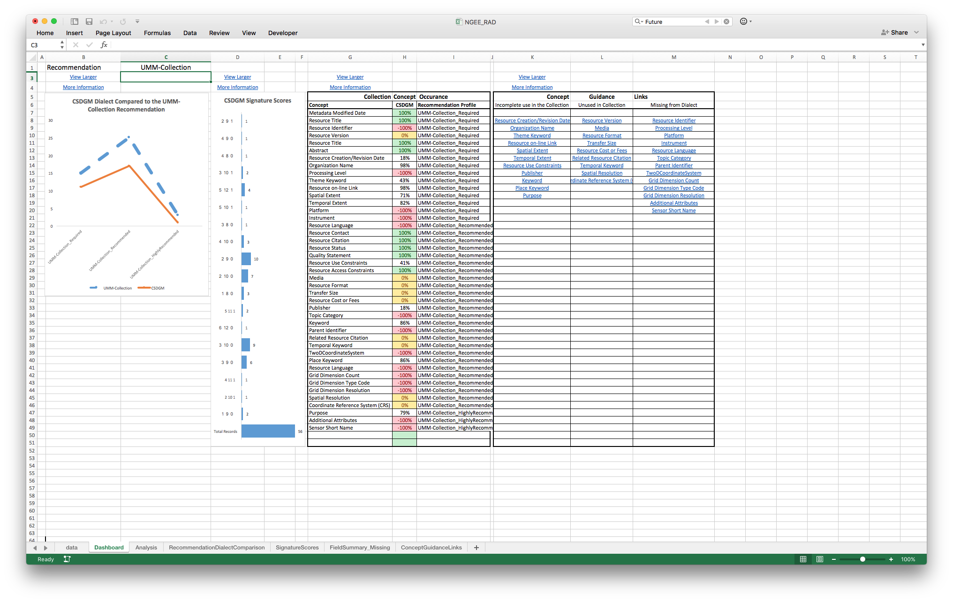
Recommendations Analysis Dashboard
data.ucar.edu
Sharable Metadata
Metadata
Documentation

Slide 7
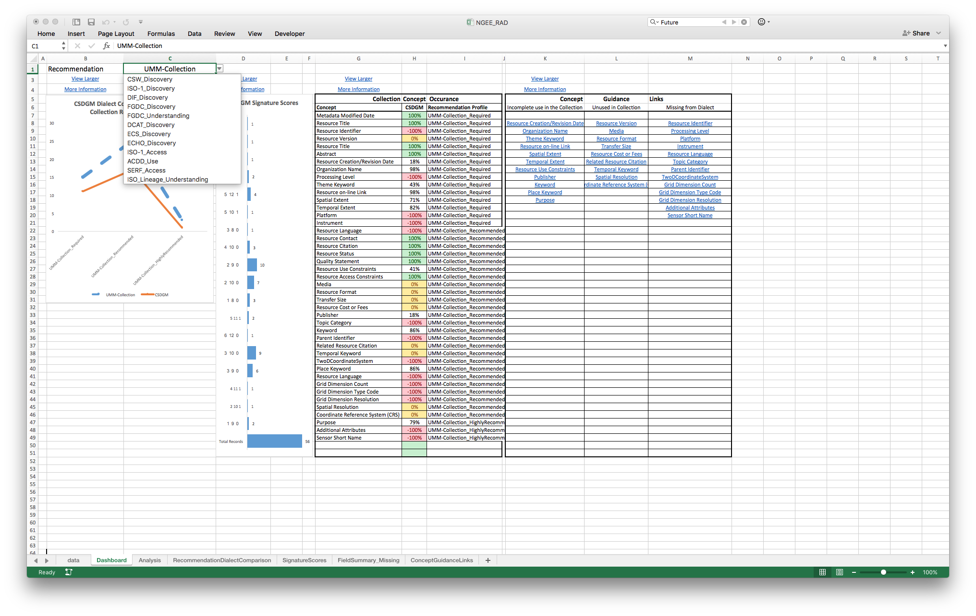
Pick a Recommendation, any Recommendation
data.ucar.edu
Sharable Metadata
Metadata
Documentation

Slide 8
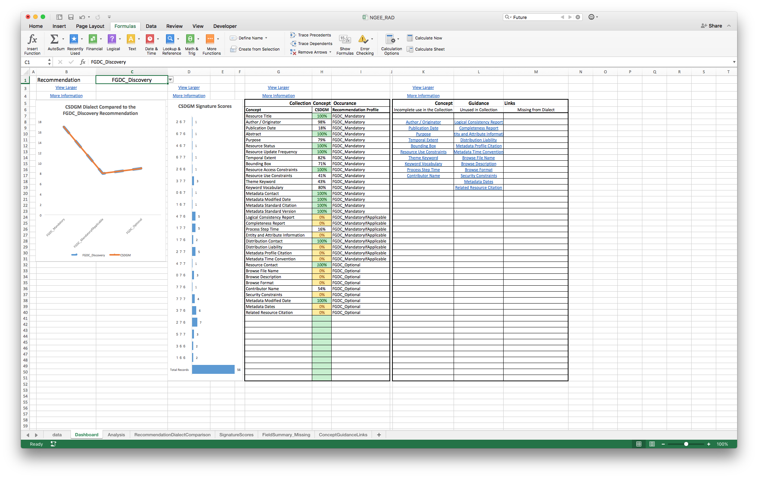
Recommendations Analysis
data.ucar.edu
Sharable Metadata
Metadata
Documentation

Slide 9
Recommendation / Dialect Comparison
data.ucar.edu
Sharable Metadata
Metadata
Documentation

Slide 10
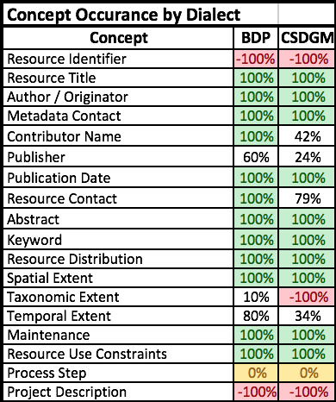
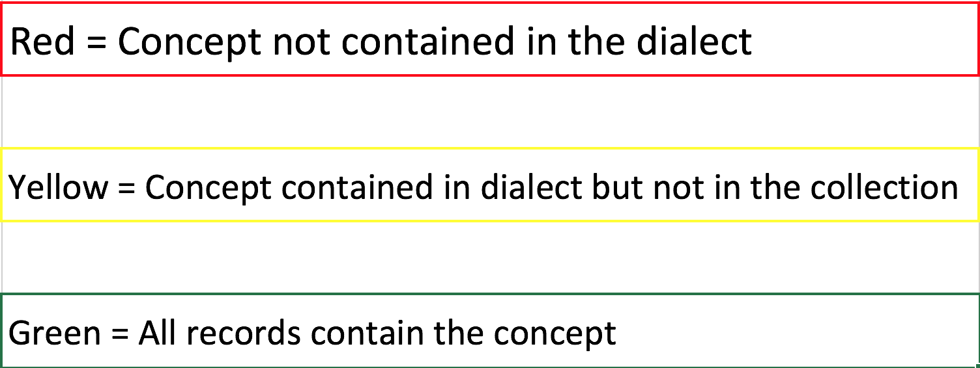
Field Summary
data.ucar.edu
Sharable Metadata
Metadata
Documentation

Slide 11
Signature Score Groups
data.ucar.edu
Sharable Metadata
Metadata
Documentation

Slide 12
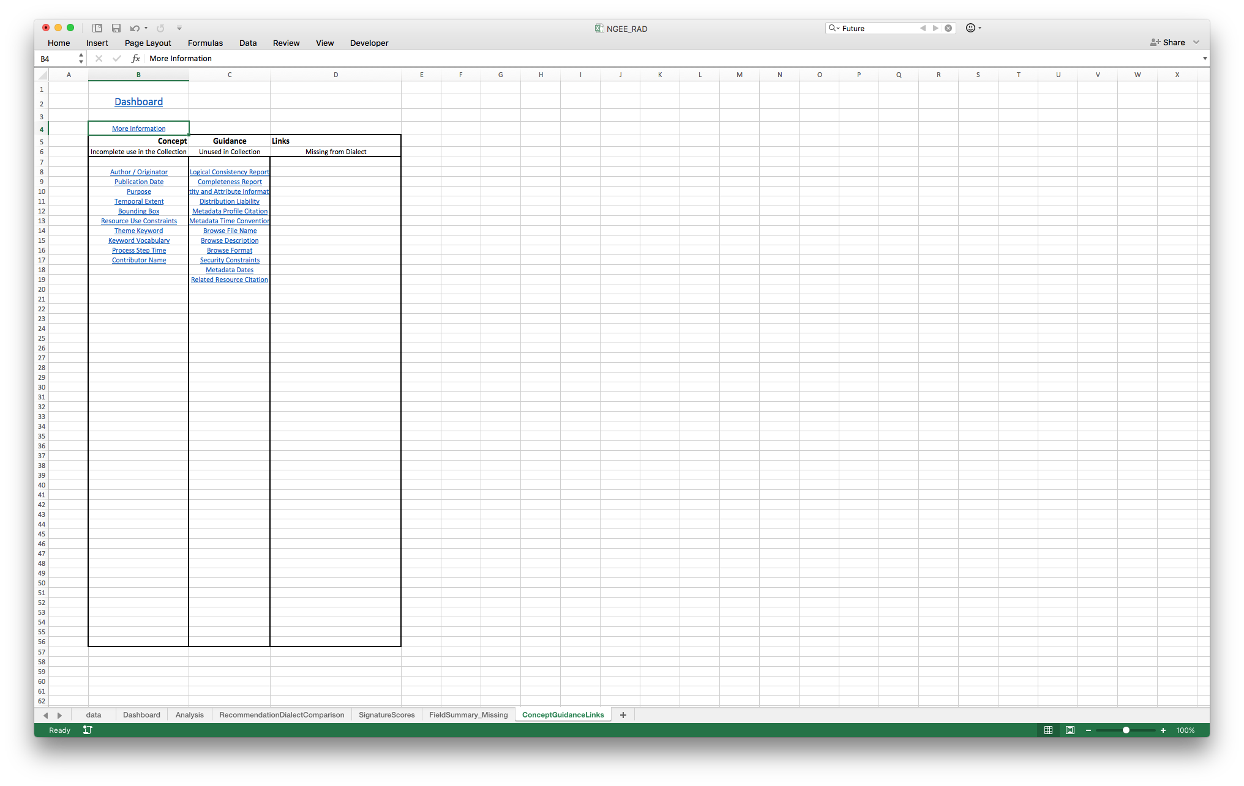
Concept Guidance Links
data.ucar.edu
Sharable Metadata
Metadata
Documentation

Slide 13
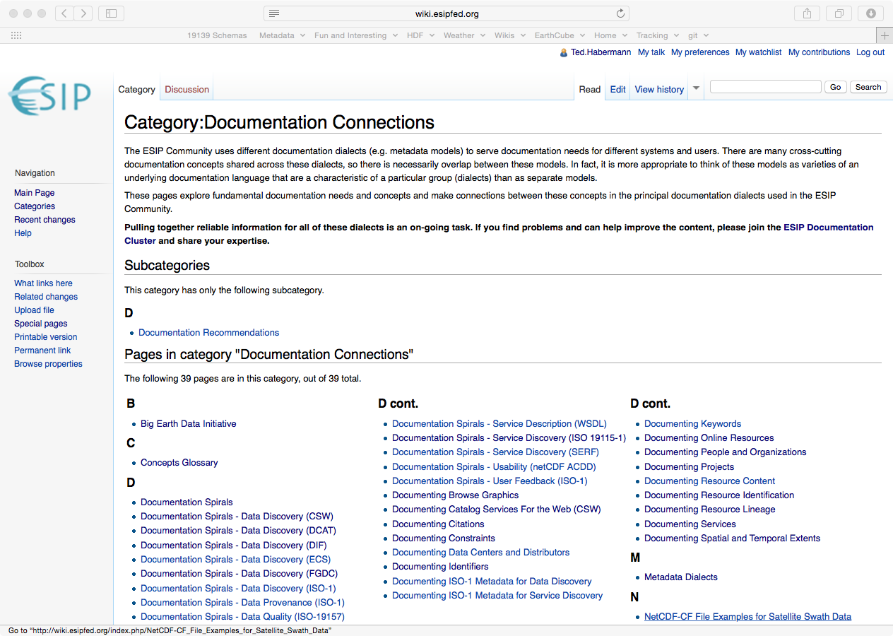
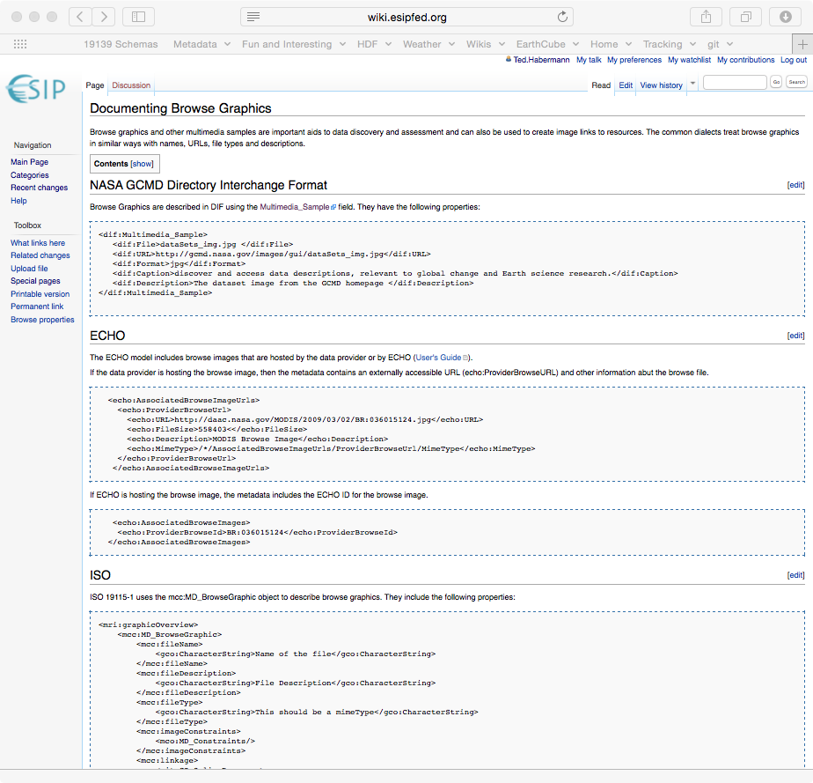
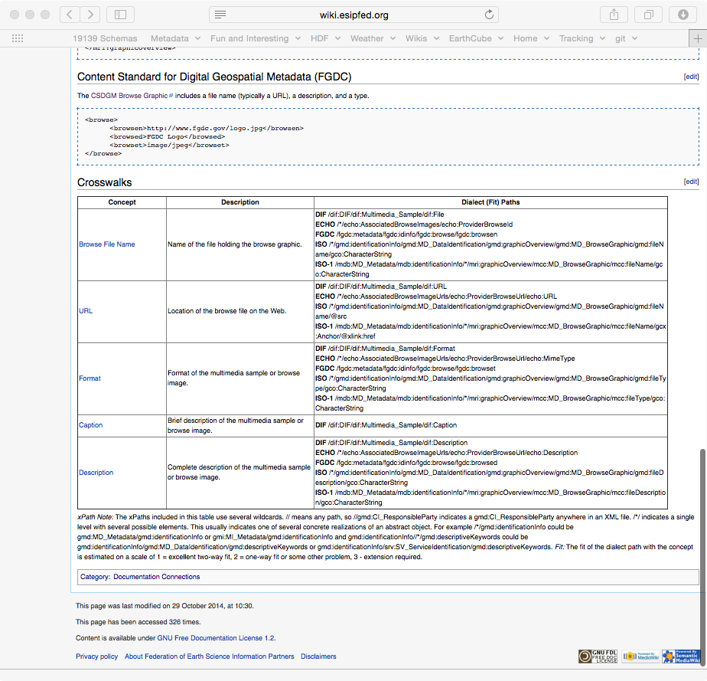
Guidance Documentation
data.ucar.edu
Sharable Metadata
Metadata
Documentation
http://wiki.esipfed.org/index.php/Category:Documentation_Connections

Slide 14
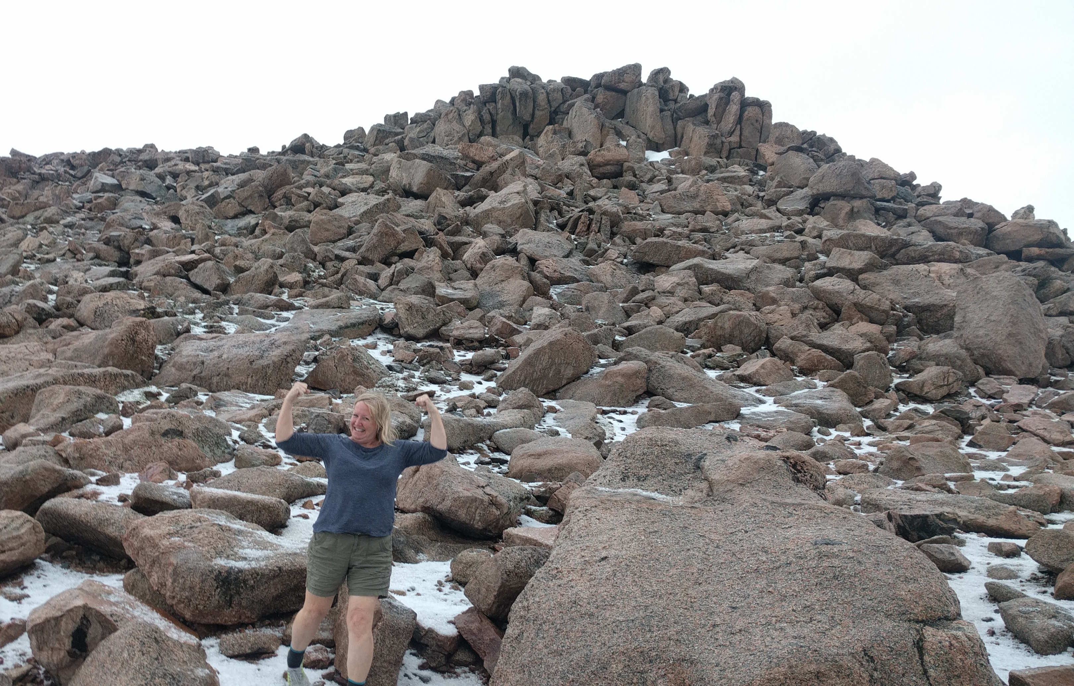
Let’s Get Involved!
data.ucar.edu
Sharable Metadata
Metadata
Documentation

